Slide 1
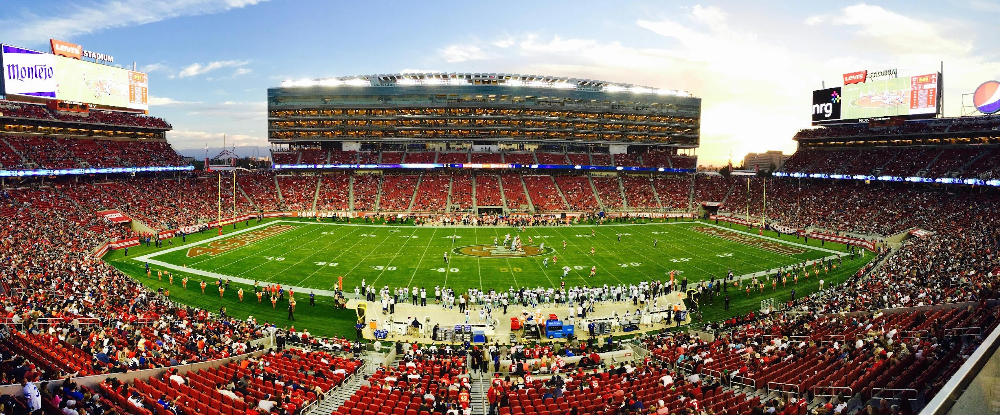

Winning Strategies: Analyzing 4th Down Tactics in American Football
ISYE-7406 Course Project
Group 75
Patrick McGee, Victor Ye, Sophia Oku, Andrew McAlister, Pranay Shah

Slide 2



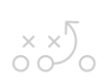

Background and Objectives
American Football was the most-watched sport in America in 2023 with the premier professional league, NFL, clocking in at almost a trillion viewed minutes.
It’s a sport often compared with chess games due to the many moving parts and split-second decision making required.
Fourth downs in particular, are pivotal moments, representing a team's final opportunity to score or advance, or risk surrendering possession.
Our goal is to optimize fourth-down play-calling strategy using data mining and statistical learning to decide between going for it, punting, or attempting a field goal to maximize win probability.

Slide 3
Problem Statement and Data Sources
Problem Statement: Apply data mining and statistical learning techniques to historical NFL play by play data to determine an NFL team’s optimal 4th down decision for a given game state. Possible decisions are (1) go for it, (2) punt, or (3) kick a field goal. Use the developed models to assess how often NFL teams decided to go for it on fourth down relative to the optimal choice.
Hypothesis: NFL teams will decide to go for it on 4th down less often than than they should.
Data Source: Every NFL play-by-play data from 2016 through 2023. Data from 2016 through 2022 is used for training/validation and data from 2023 is used for analysis. Each play contains 384 features. Data is accessed through nfl_data_py Python library.
See Appendix for the variables used in our models, along with a description of each variable.

Slide 4
Methodology Overview
Optimal decision = decision with greatest increase to the team’s “Win Probability”
Methodology involves development of several interrelated models that support arriving at optimal decision. Presentation includes methodology, analysis, and results of each model in addition to the overall analysis of the entire project.
Task 1: Develop a “Win Probability” Model, which calculates the probability that the offensive team will win the game given the current game state (down, yard line, score differential, time remaining, etc.).
Task 2: Develop a Probability Density Functions (PDFs) and/or Probability Mass Functions (PMFs), that are associated with each potential 4th down decision: go-for-it, kick a field goal, or punt. PDFs and PMFs will take into account the game state at the time of the decision.
Task 3: Develop a Simulation Model, which uses the PDFs / PMFs to simulate running each play type a large number of times and uses the Win Probability Model to determine the expected impact on Win Probability from each decision.
Task 4: Use Win Probability Model, PDFs/PMFs, and Simulation Model to perform analysis and report results.

Slide 5
Methodology Overview
Data set
Win probability model
Calc Win probability of all three play types
Select highest win probability play using simulation
Compare Win probability
Cluster dataset k-means
Go for it and punt PMFs / cluster
Field Goal Made it Probability

Slide 6
Task 1: Methodology and Results – Win Probability Model
Subtask Problem Statement: Develop a “win probability” model that accurately predicts the probability that an NFL team would win a game given a set of in-game conditions.
Data Source: Every NFL play-by-play data from 2016 through 2023. Data from 2016 through 2022 is used for training/validation and data from 2023 is used for analysis. Each play contains 384 features. Data is accessed through nfl_data_py Python library.
Replicate Yurko Win Probability Model: Our first step was to replicate the win probability model detailed in an academic research paper by Yurko, Ventura, and Horowitz (2018)¹. This model is based on a generalized additive model (GAM) and serves as a baseline for comparison of other newly developed models.
Develop Win Probability Models using a variety of Statistical Learning Algorithms:
Logistic Regression
Random Forest
AdaBoost
Gradient Boost Machine (GBM)
Extreme Gradient Boost (XGBoost)

Slide 7
Methodology – Win Probability Model
Determine Error Measurement to use to Assess Model Performance:
Traditional measures of classification error (e.g. misclassification rate, accuracy, precision, recall, etc.) are not good measures predicted probabilities.
Instead used an error measure better suited to measure the accuracy of predicted probabilities.
Predicted probabilities split into 20 bins. Mean absolute error between the predicted probability and the observed probability calculated for each bin. Weighted average error of each bin provides a single measure of a model’s performance.
Same method as Yurko, Ventura, and Horowitz (2018)¹ in their academic paper.
See appendix for more details.
Perform Cross-Validation:
Used cross-validation to compare performance of different models, parameter values within a model, and selected variables.
Used leave one season out (LOSO) cross-validation, which is essentially k-fold cross-validation where each fold represented one season. Seven seasons, 2016 to 2022, were used.

Slide 8
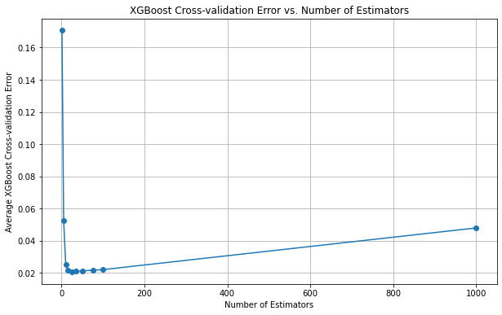
Methodology – Win Probability Model
Tune Parameters: While performing cross-validation, parameter tuning was used to optimize performance. Below is a graph of tuning the final selected model, XGBoost. The optimal value of this parameter is 25 estimators.
Perform Variable Selection: Initial variable selection was based on domain knowledge of features most likely to be relevant. Cross-validation showed no improvement to initial selection.

Slide 9
Results – Win Probability Model
Select Best Performing Model: Six model types were trained and their performance was assessed through cross-validation. XGBoost was the best-performing model and was chosen.
Test XGBoost Performance on 2023 Data and Compare to Yurko GAM Model:
XGBoost re-trained with all training data (2016-2022) and used on 2023 test data.
Mean absolute error for XGBoost on 2023 test data was 0.0127.
XGBoost outperformed GAM on 2023 data, which had an error rate of 0.0138.
Model Type | CV Mean Absolute Error
Logistic Regression | 0.0209
Random Forest | 0.053
AdaBoost | 0.2333
Gradient Boosting Machine (GBM) | 0.0226
Extreme Gradient Boosting (XGBoost) | 0.0207
Generalized Additive Model (GAM) | 0.0220

Slide 10
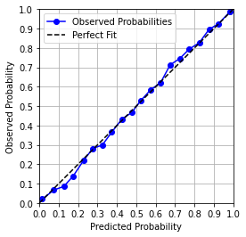
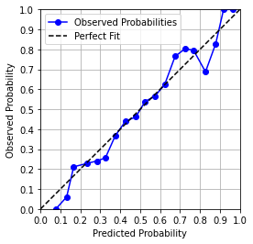
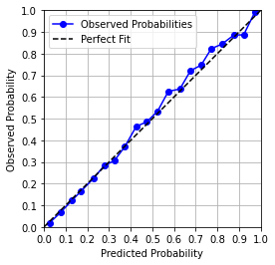
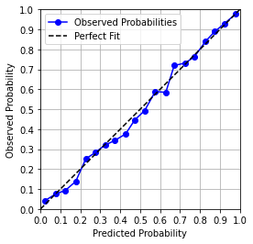
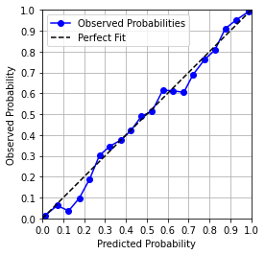
Results – Win Probability Model
Check that Model is Well-Calibrated Across Range of Probabilities and Across Four Quarters:
The model was checked using the tailored error measurement across a range of probabilities, the whole game, and all four quarters.
Below are plots of actual model performance on 2023 data.
For a perfect fit, the blue line should be on the dotted line.
Whole Game
1st Quarter
2nd Quarter
3rd Quarter
4th Quarter

Slide 11
Task 2: Methodology and Results – PDFs and PMFs
Subtask Problem Statement: Develop Probability Density Functions (PDFs) and/or Probability Mass Functions (PMFs) that can be used to simulate each potential 4th down decision: go-for-it, kick a field goal, or punt. PDFs/PMFs should take into account the game state at the time of the decision.
Data Source: The training data set, which consisted of every NFL play-by-play data from 2016 through 2022. Each play contains 384 features. Data is accessed through nfl_data_py Python library.
Complexity Reduction: The problem of developing a density estimation for every possible game state is complex. We reduced the complexity of the problem through two methods:
Performed k-means clustering to develop clusters of similar game scenarios and developed Probability Mass Functions for each cluster.
Used domain knowledge of football to group game scenarios. We assumed plays with the same ‘yards to go’ would have similar Probability Mass Functions (PMFs). We assumed that teams are trying to gain a minimum of the yards to go when they are going for it on 4th down, and that plays would be similar across different yard lines, game times, and other game scenarios.

Slide 12
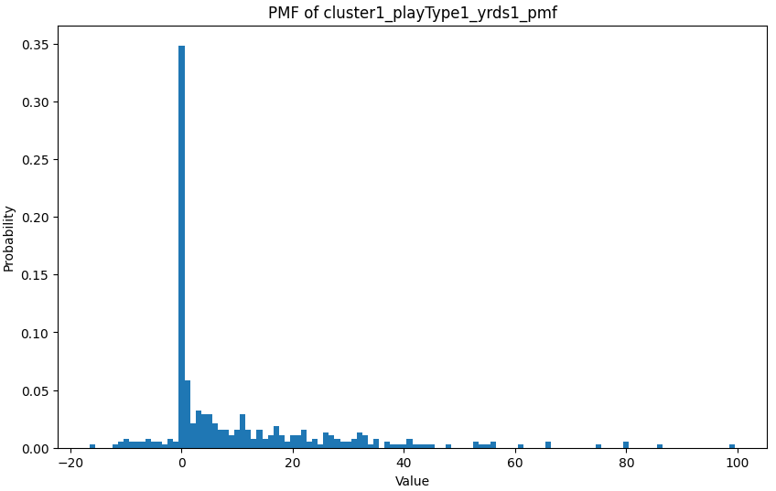
Probability Mass Functions / Probability Density Functions
Developed both PDFs and PMFs.
PMFs were considered a better fit and were chosen over PDFs
Detailed methodology and results of PDF development are included in the Appendix.
PMF Advantage: NFL data often consists of discrete events, such as yards to go, yardline to touchdown, or field goals. These events can be counted and are inherently discrete
PMF Applicability: The PMF is specifically designed for discrete random variables. It assigns probabilities to individual outcomes in a sample space.
PMF Interpretation: For a discrete random variable, the PMF provides the actual probabilities of specific outcomes. If (X) is a discrete random variable, the PMF (P(X = x)) gives the probability of (X) taking the value (x)
PDF Interpretation: In contrast, the PDF is a density function for continuous random variables. It does not directly give probabilities but describes the relative likelihood of observing values within a range
Fig. Sample PMF

Slide 13
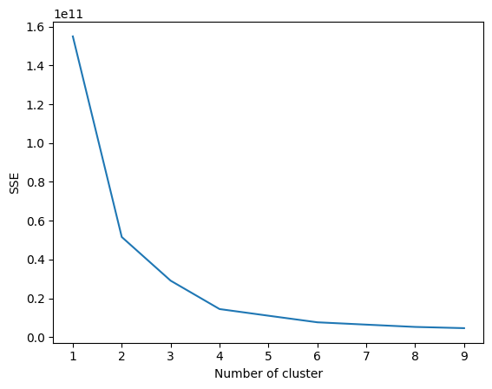
K-Means Clustering
To train the K-means model, the data was filtered by 'goforit', 'punt', 'field_goal' for all plays.
Rather than choosing a random number of cluster, this provides the statistical analysis to determine the optimal cluster to use based on our data set.
A label encoder was included to map all categorical data. This same encoded mapping will be used for new dataset for prediction.
The model was trained using train_cluster_model(df, n_clusters=4)
The model prediction was done using predict_cluster(kmeans, encoders, df)
Fig. Optimum number of clusters against SSE
The elbow point on the kmeans plot was at 4 clusters. This means that at k = 4, majority of the variance will be captured by the model.

Slide 14
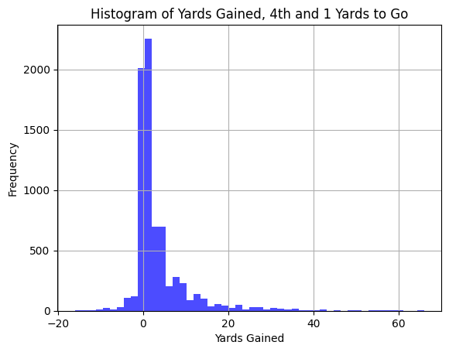
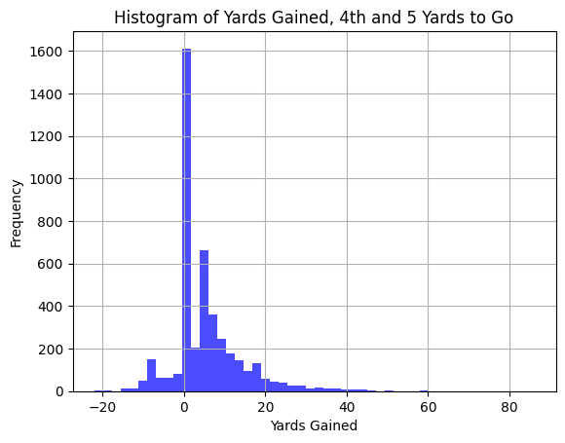
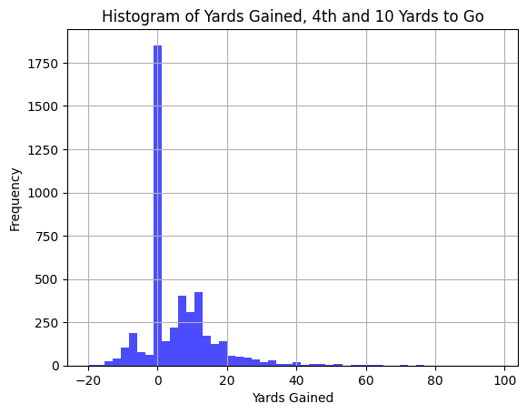
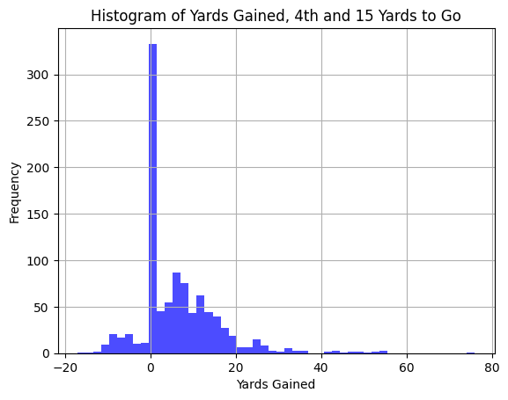
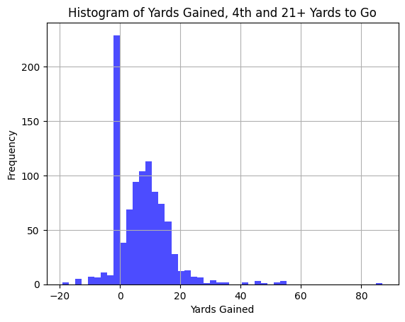
PMF Development
‘Go for it’ Approach 1 - Clustering
PMFs of ‘yards gained’ was developed for the play type ‘go for it’.
Each row in the play by play dataset is assigned to one of the four clusters, a play type (goforit in this case), and yards to go (broken down to 0, 1, 2, 3, 4, 5, 6, 7, 8, 9, and 10+ bins).
‘Go for it’ Approach 2 – “Yards to Go “ Only
PMFs of ‘yards gained’ was developed for the play type ‘go for it’. Density estimations based solely on the “yards to go” for a first down (broken down in this case from 1 to 21+) Assumption is teams are trying to gain a minimum of the yards to go on 4th down. Representative PMFs are shown below.
Punt PMF developed similarly. Please see Appendix for Field Goal PMF development details.

Slide 15
Task 3: Methodology and Results - Simulation Model
Our project uses a simulation model to integrate the win probability and individual play projections to produce expected win probabilities for a given game situation across three typical decisions on a 4th down: go for it, punt, or kick a field goal.
The model follows this process:
Beginning with a game state (down, yardline, yards to a first down, possessing team, etc.) determine the current win probability.
Over a selected number of iterations (determined by the user) simulate the results of that many iterations if the possessing team were to go for it, punt, or kick a field goal.
Based on each of those simulated plays create a new game state factoring in the result (new first down, scoring a touchdown or field goal, punting to the other team, or turning the ball over to the other team).
Run the new game states through the win probability model to get an updated win probability.
Average the new win probability over the selected iterations to generate an expected win probability for each potential 4th down decision (go for it, punt, or kick a field goal).
Compare the initial win probability for the entered game state against the expected win probabilities of the 3 decisions to determine the best decision to make.

Slide 16
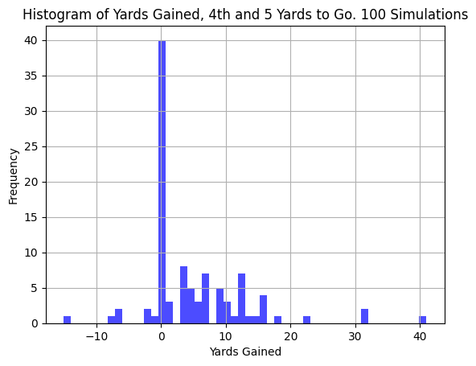
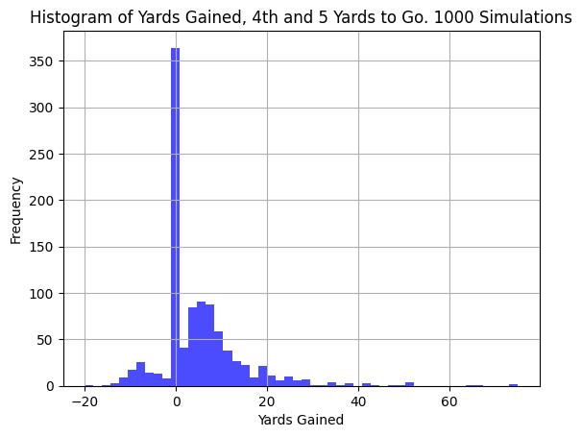
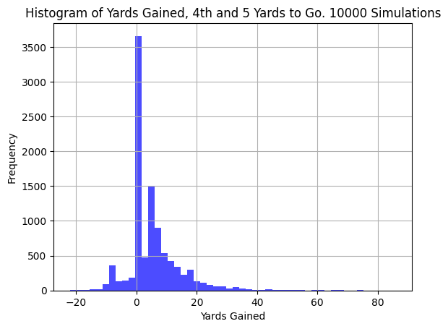
Task 3: Methodology and Results - Simulation Model
Simulation process involves:
Selecting the relevant PMF for a play’s game state
Converting the PMF into a CDF
Generating a random number between 0 and 1
Using inverse transform to find the appropriate yards gained from the PMFs
Simulation model validation:
Verified that the simulation model was able to re-create the given PMF input model
As shown below, 10,000 simulations almost perfectly re-creates the PMF
Original PMF
100 Simulations
1,000 Simulations
10,000 Simulations

Slide 17
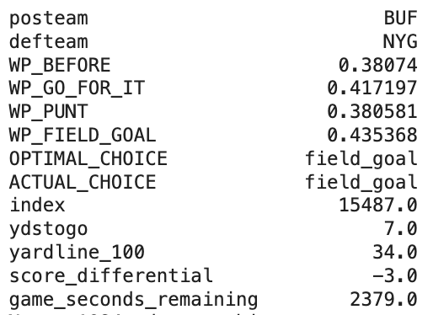
Analysis and Results - Overall Project
Analyzed 3,605 fourth down plays in the 2023 season.
These 3,605 plays consisted of all fourth down plays in the season after filtering out edge cases that win probability model either could not handle or handled poorly.
Plays under two minutes in either half
Overtime plays
Play types that were not run, pass, field goal, or punt
Analysis for each play included:
Calculation of win probability at the start of the play
Calculation of win probabilities for go for it, field goal, and punt using PMFs and simulation model described earlier
Calculation of optimal decision based on win probabilities described above
Offensive team and the actual decision
Output Data for 1 of the
Analyzed 3,605 Plays

Slide 18

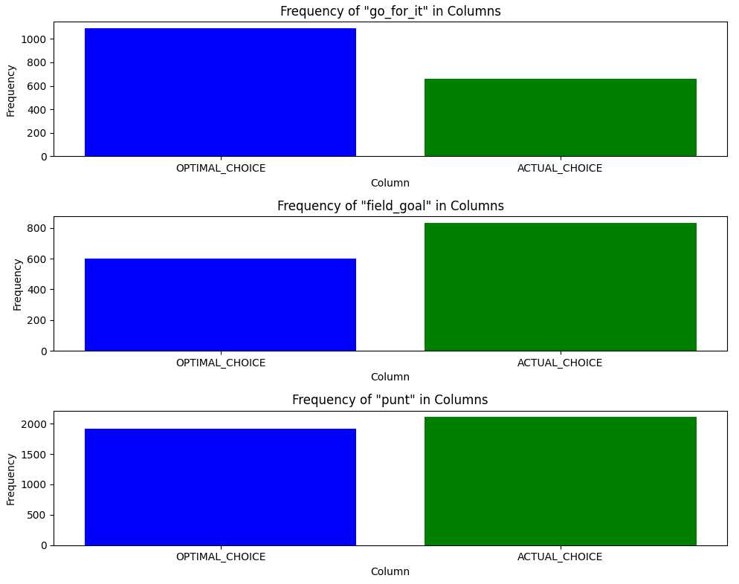
Model Scenario Analysis & Base Stats
Hypothesis was supported
Teams are less aggressive in real-life compared to what our model suggests based on the higher likelihood of success if teams did “go for it” on fourth down.
Teams will often choose the safer option of scoring a field goal rather than pushing to get the first down.
Next slide shows a heat map comparing ratio of actual to optimal ‘go for it’ decisions by team. Ten teams went for it too often, Tampa Bay went for it at the optimal rate, and 21 teams went for it too little.

Slide 19
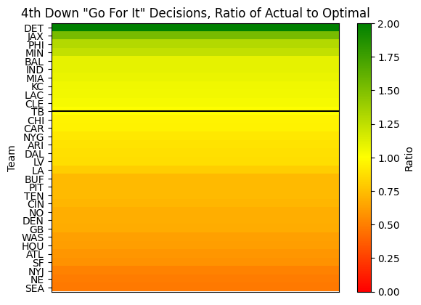
Team Analysis
Too Aggressive
Optimal Rate
Too Conservative

Slide 20
Conclusion
Overall, our methodology to solving the problem seems like a sound approach - we were able to generate output data that seemed reasonable for a decent number of plays.
Additionally, at a macro-level our analysis generated results that confirmed our hypothesis (and the opinions of experts): Teams in real-life tend to be more risk-averse than our model suggests they should be. The optimal choice in some scenarios is to “go for it” rather than to kick a field goal or punt.
However, there were more results that seemed off than we had expected given the relatively low error rate of the Win Probability model during cross validation (i.e. error of +/- 1.27 percentage pts)
We believe that areas of improvement include:
Improve PMFs overall. We ran into some issues implementing our more sophisticated PMFs and were only able to implement simplified density estimations.
The win probability model needs to be updated to better handle edge cases.
Additionally, the win probability model needs to be accurate over all game states to minimize or eliminate the potential of any suboptimal recommendations. We need a way to quantify this requirement so that we can use cross validation to achieve it.

Slide 21
Possible Future Work
Implement our improved PMFs (possibly in time for the final report).
Explore improvements to the win probability model with particular focus on accuracy for all game states.

Slide 22
Appendix

Slide 23

Data Overview
Variable | Description
Down | The down for the given play - we’re primarily focusing on the fourth down
Half_seconds_remaining | Number of seconds left in whichever half the game is currently in
Yardline_100 | Distance (yards) to go to opponent’s end zone for the possession team
Goal_to_go | Binary indicator for whether possession team is in a goal down situation
Score_differential | Possession team score minus defense team score
Game_half | H1 = first half, H2 = second half, OT = overtime
Posteam | Team with the possession of the ball
Defteam | Team defending against the team that has possession of the ball

Slide 24
Data Overview (Cont’d)
Variable | Description
Posteam_timeouts_remaining | Number of timeouts remaining for the team with possession of the ball
Defteam_timeouts_remaining | Number of timeouts remaining for the team that’s defending
Game_seconds_remaining | Numeric seconds remaining in the overall game
Ydstogo | Numeric yards in distance from line of scrimmage to first down or end zone
Natural Log of Ydstogo | Natural log of yards to go
UnderTwoMinutes | 1 = under two minutes in the half, 0 = otherwise
ln(Ydstogo) x Down | Interaction term between ln(Ydstogo) and down
Yardline x Down | Interaction term between yardline_100 and down
ln(Ydstogo) x Goal_to_go | Interaction term between ln(Ydstogo) and goal_to_go

Slide 25
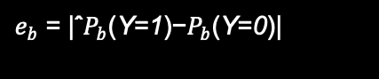
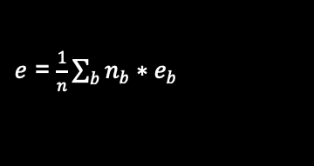
Methodology Overview – Win Probability Model
Determine Error Measurement to use to Assess Model Performance: We implemented a method of evaluating performance that was developed by Yurko, Ventura, and Horowitz (2018) for use on their win probability model. Using this method, the predicted probabilities are compared to observed probabilities by creating bins that aggregate similar predictions together. The win probabilities are binned in five percent increments leading to 20 possible bins total. All of the predicted probabilities with a value that falls within the range of a bin (e.g. 0.15 to 0.20) are aggregated together and the mean predicted probability of this aggregated group is calculated (e.g. 0.185). The observed probability of this bin is calculated as the actual number of times the binned observations won divided by the number of observations in the bin.
The error associated with a bin is the absolute value of the difference between the predicted probability and the observed probability.
The mean absolute error is the weighted average of the mean absolute errors of the bins.

Slide 26
Empirical Data Analysis and Data Preparation
Created more features in addition to the ones created for the WinProb model, such as:
Total_yards_gained - summation of all yards gained
Successful_play - if yards gained > 1 or made it for field goal
Field_goal_result_num - boolean on made it or missed/blocked
These were created as a manipulation or engineering of other pre-existing variables in the dataset
The engineered variables are particularly important for training the baseline cluster model
The K Means model is trained with the addition of successful plays as an example
Further down the model pipeline, total_yards_gained is once again manipulated via fit_transform so that the categorized input to the model can adhere to K Means assumptions
Due to proper scaling and feature engineering, KS-Statistic values were in line for both distribution test, within the expectations for the K Means model and no group broke the p-value threshold of 0.05
Based on initial thought and further discovery phase, we decided to switch from PDFs to PMFs for go for it and punt distribution. This is based on discrete behavior of the NFL play rather than continuous scenarios.
Field goal results in whether you make it or miss, in this instance, logistic regression was deemed as the best solution

Slide 27
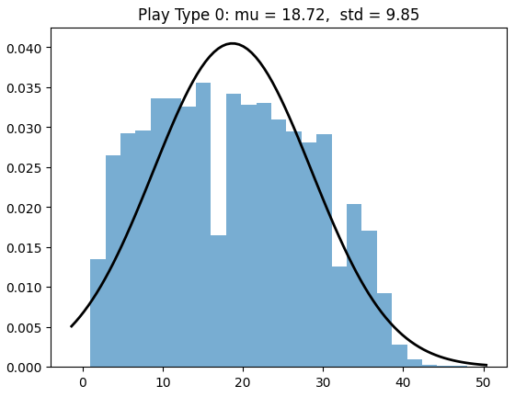
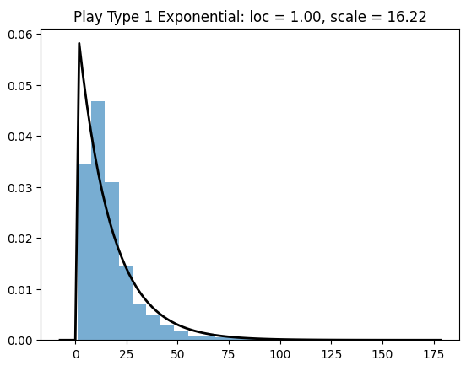
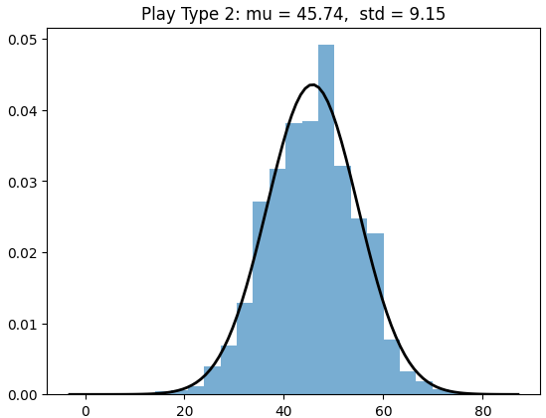
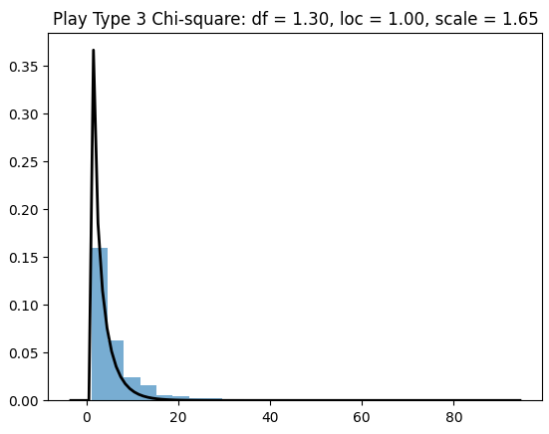
Probability Density Function
Original idea is to get the PDFs to understand a continuous distribution of gamestate results by play types
Initial creation of probability density function on successful plays only
Tested fit of each play type distribution to Normal, Exponential or Chi-square fit
Run and Pass (1 and 3 in this view) plays are visually closer to exponential
Field goal and punt are closer to normal distribution
Fig. PDF sample by play type

Slide 28
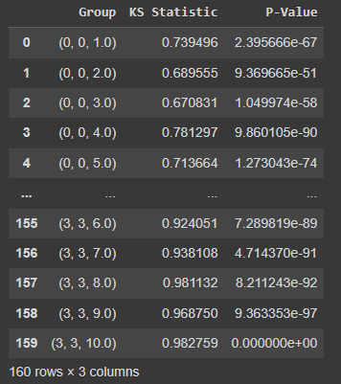
Probability Density Function
Fig. KS test results
To ensure that we aren’t just visualizing the distribution, but we put it through the Kolmogorov-Smirnov (KS) test
Normal distribution test on field goal and punt play type
The KS test compares the empirical cumulative distribution function (ECDF) of our play type data to the cumulative distribution function (CDF) of a normal distribution
The p value were all < 0.05, where we reject the H0
Exponential distribution test on run and pass play type
The KS test for exponentiality compares the ECDF of our play type data with the theoretical exponential CDF (1 - exp(-x))
The p value were all < 0.05, where we reject the H0

Slide 29

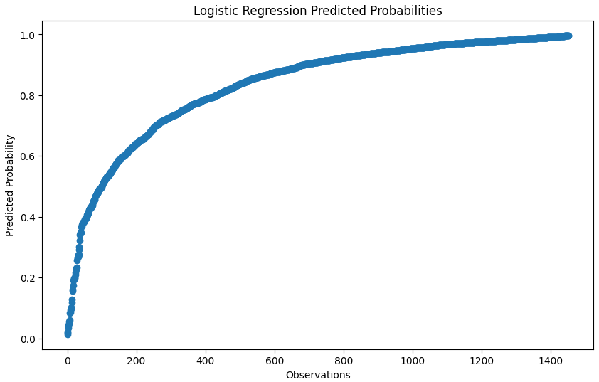
Model - Field Goal %
For field goal, the main outcome of interest is not distance. Hence, in this case, the usage of PMFs will not make sense. Therefore, we had opted to use win probability instead.
Initially, calculating field goals made vs total field goals was used. However, to increase accuracy based on game state, we’ve switched to use logistic regression.
Logistic Regression
Using same encoder from k-means. Adjust all categories and to fit model based on 1 or 0.
New data will use the same model to predict made it probability
If yardline 100 is greater than 45, we would automatically assume made it probability is 0; otherwise, use probability
Fig. Sample Predicted Probabilities

Slide 30
Credits
Yurko, Ronald, Ventura, Samuel and Horowitz, Maksim. "nflWAR: a reproducible method for offensive player evaluation in football" Journal of Quantitative Analysis in Sports, vol. 15, no. 3, 2019, pp. 163-183. https://doi.org/10.1515/jqas-2018-0010

